Slide 1
Advanced Python Workshop
Presented By:
Ali Waheed
Ahsan Goheer

Slide 2
Motivation

Slide 3
Workshop Outline
Session – 1
Setting up the code editor.
AutoEDA using Dtale.
Developing Web Apps using Streamlit.
Experimentation and Development of ML pipeline using PyCaret.
Session – 2
Deploying ML pipeline and Models using Fast API.
Containerization using Docker.

Slide 4
Our Philosophy
“I would rather have questions that can't be answered than answers that can't be questioned.” ― Richard Feynman

Slide 5
Session - 1

Slide 6
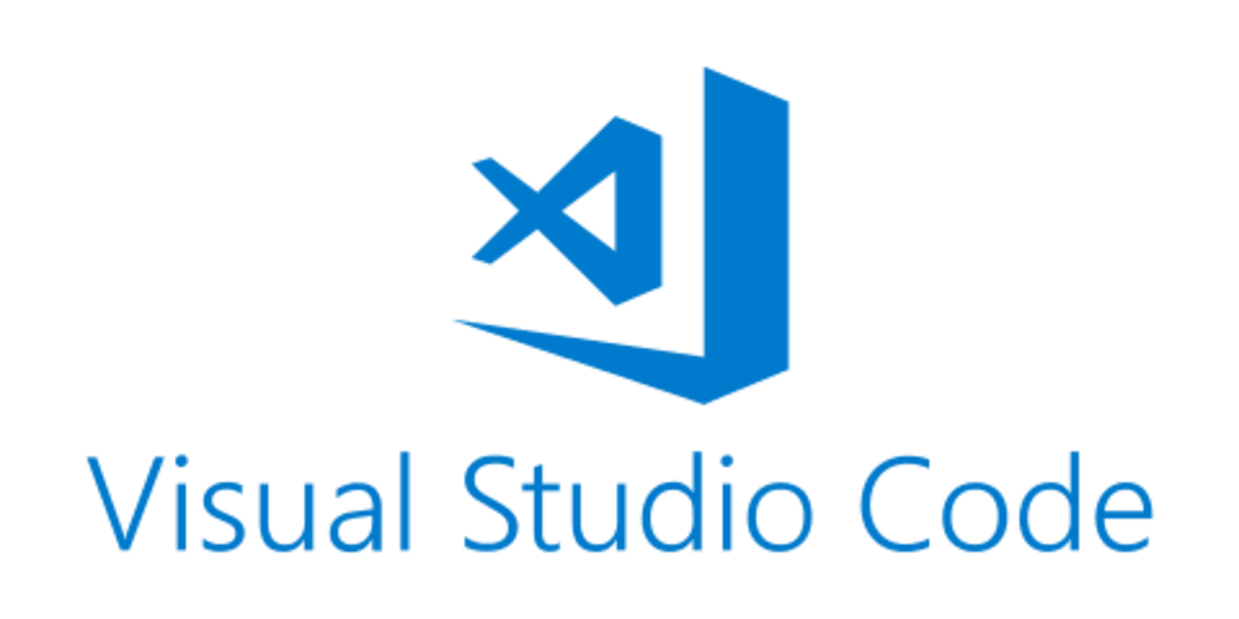
Setting up the Code Editor

Slide 7
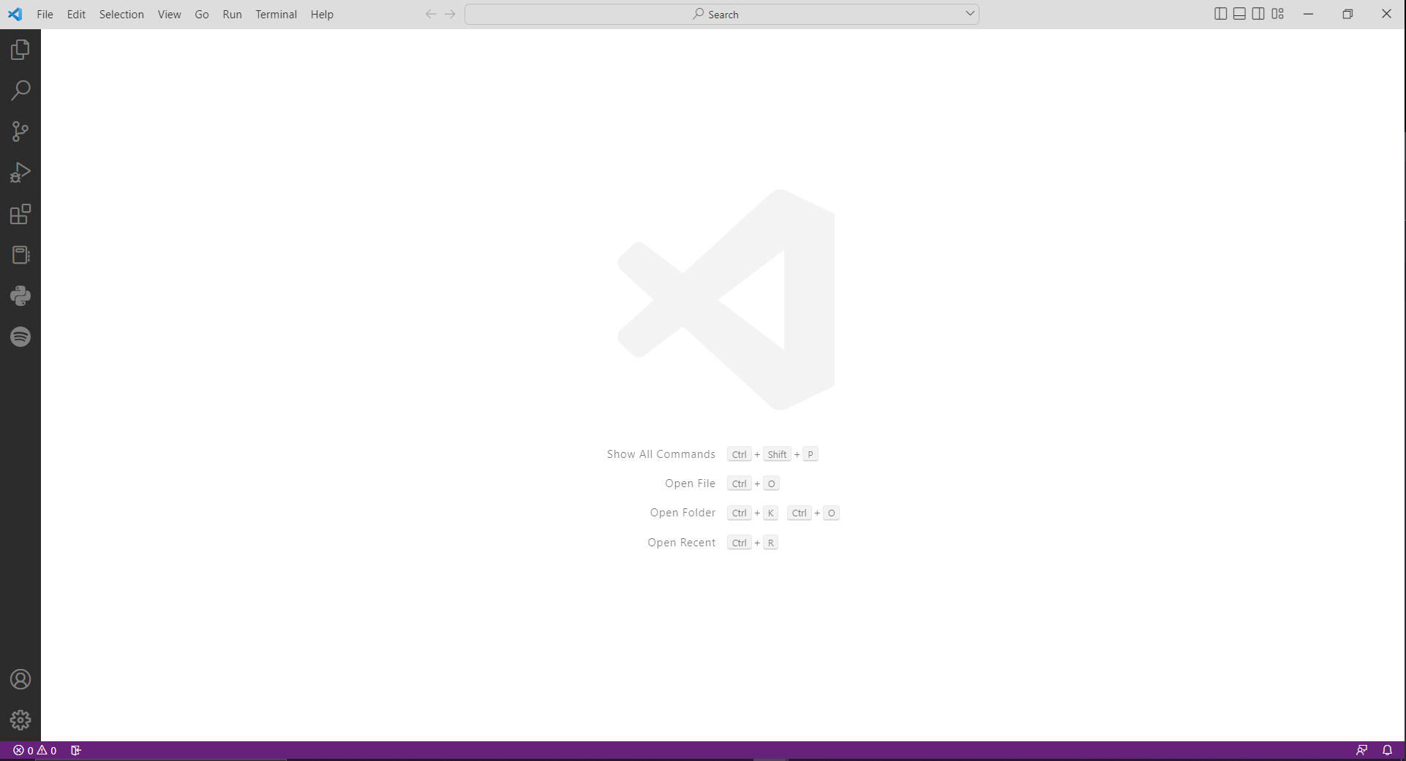
Downloading VS Code
VS Code is a free code editor that can be downloaded from https://code.visualstudio.com/
Benefits:
Lightweight.
Has an extensive library of extensions.
Highly Customizable.
Comes with version control integration options.

Slide 8
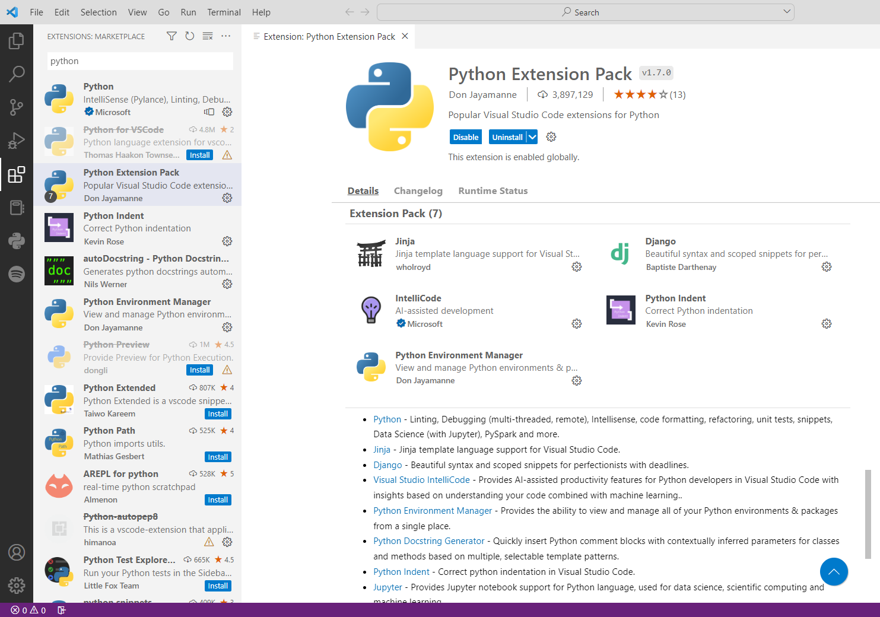
Installing Python Extensions

Slide 9
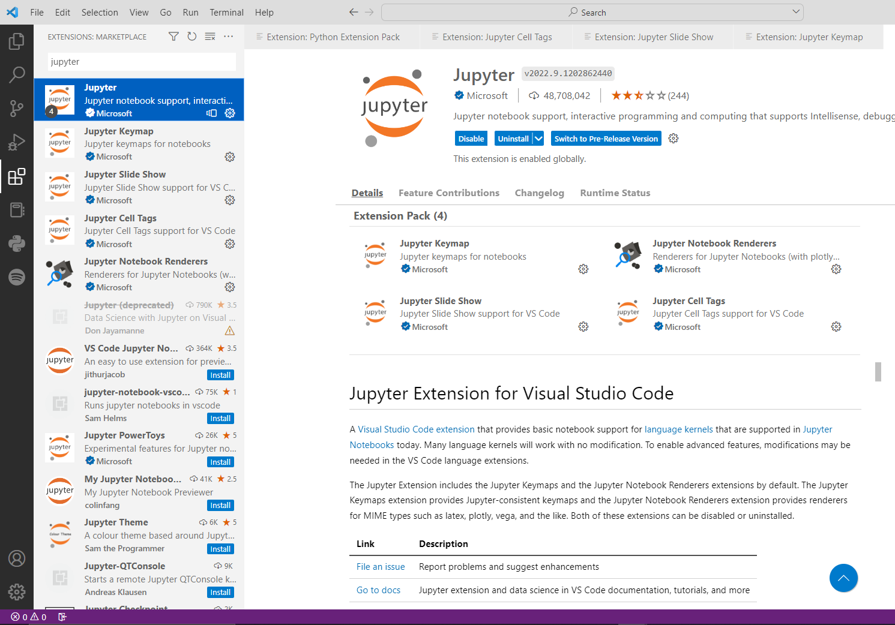
Installing Jupyter Extensions

Slide 10
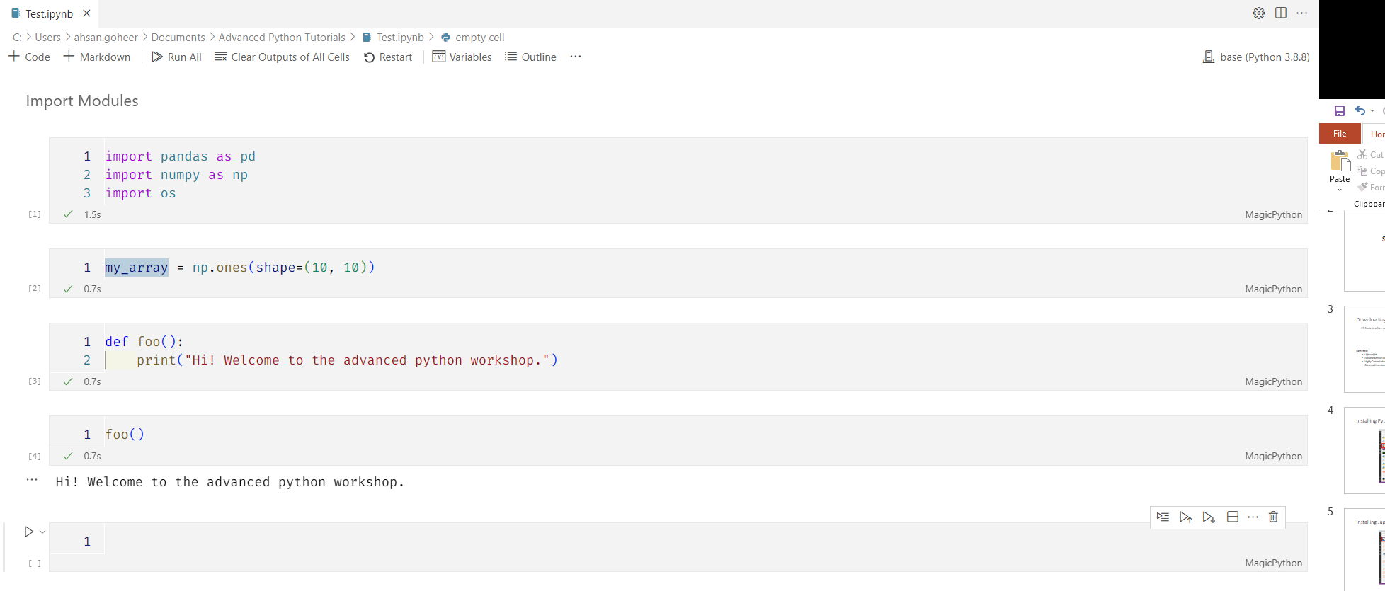
Jupyter notebooks in VS Code.

Slide 11
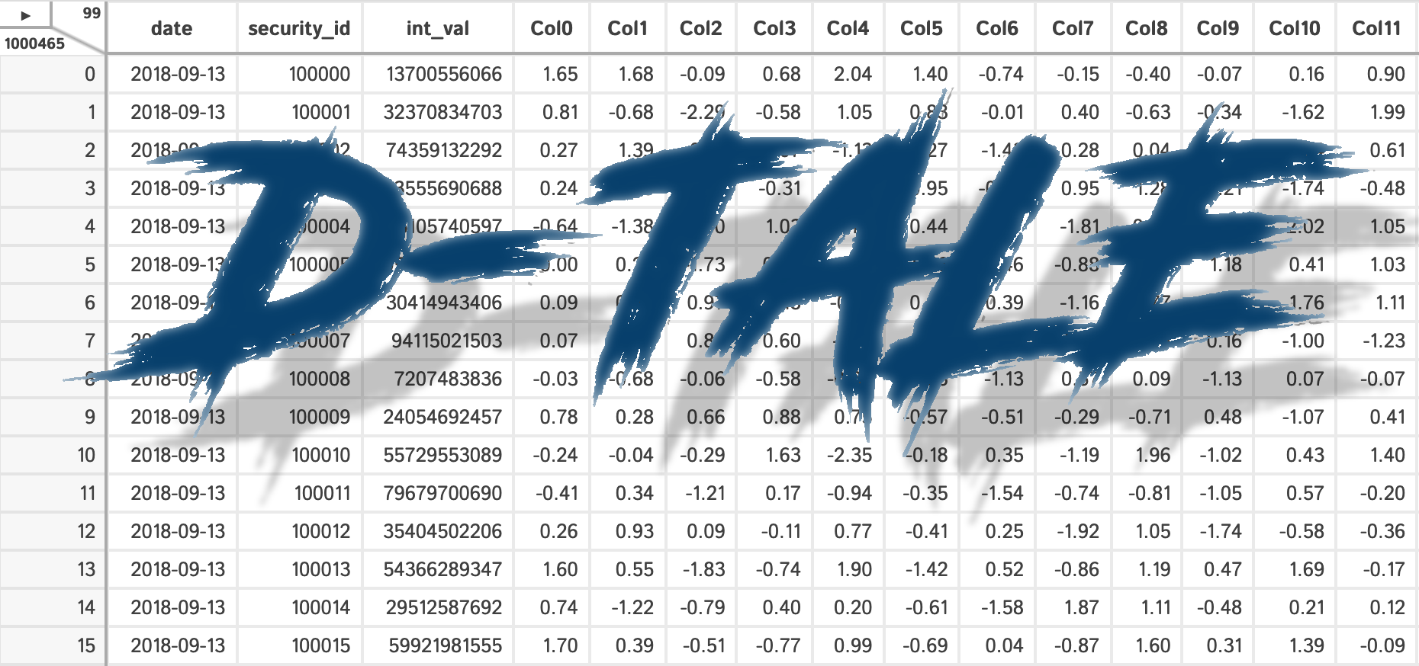
EDA using Dtale

Slide 12
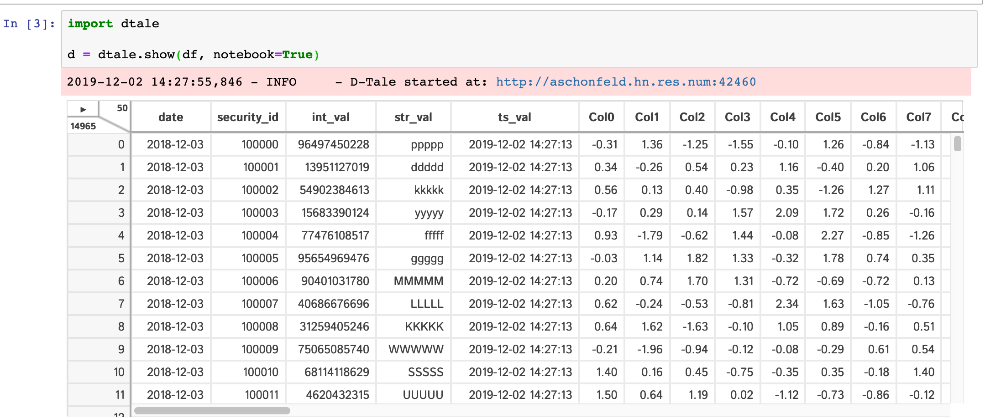
What is Dtale?
D-Tale is the combination of a Flask back-end and a React front-end to bring you an easy way to view and analyze Pandas data structures. It integrates seamlessly with Ipython notebooks and python/Ipython terminals. Currently this tool supports such Pandas objects as DataFrame, Series, MultiIndex, DatetimeIndex and RangeIndex.

Slide 13
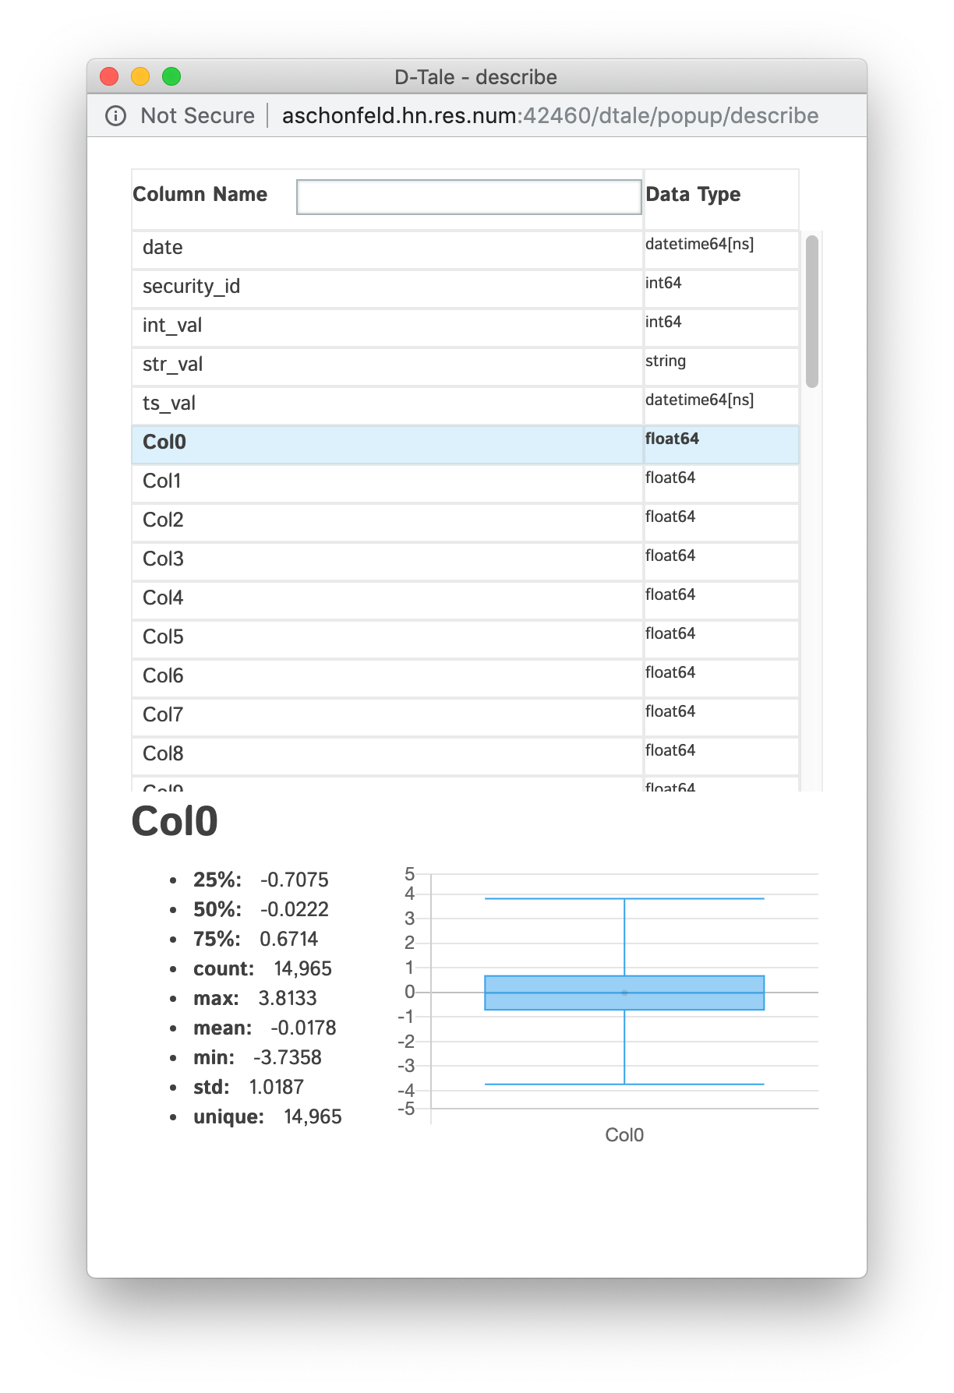
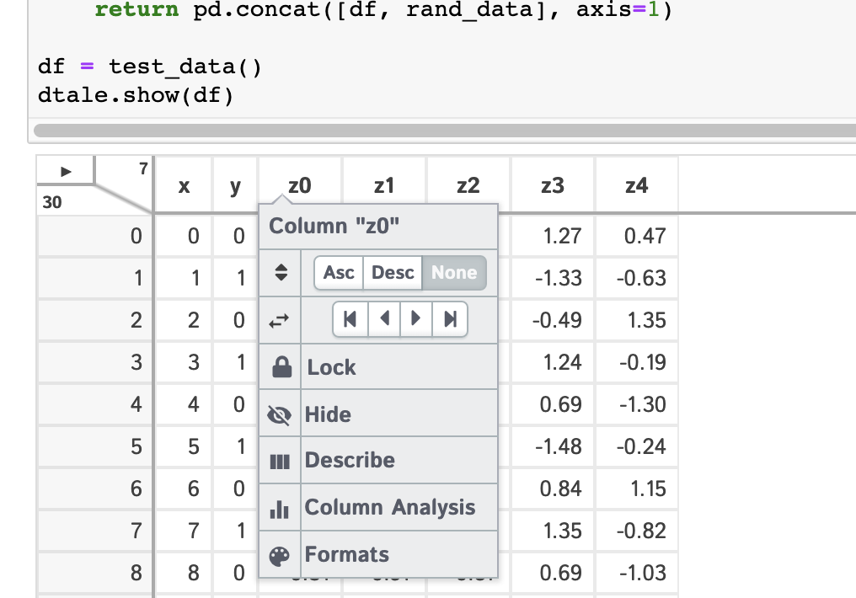
Things you can do with Dtale.
Apply pandas operations on columns using a UI.
Get the description of the entire data frame.

Slide 14
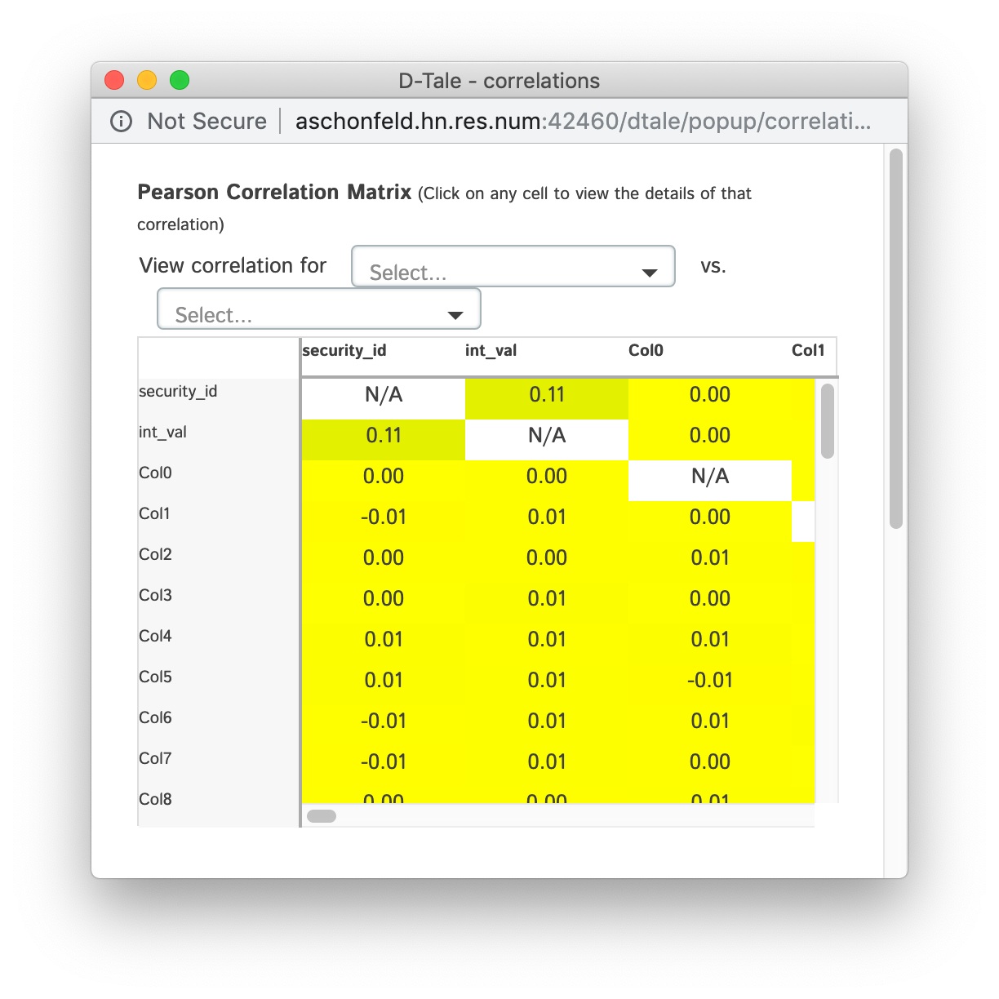
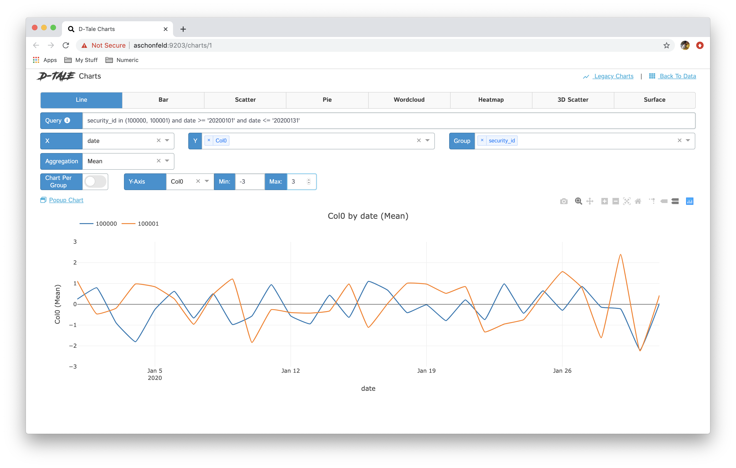
Things you can do with Dtale.
Study relationships between different features.
Instantly create visualizations without any code.

Slide 15
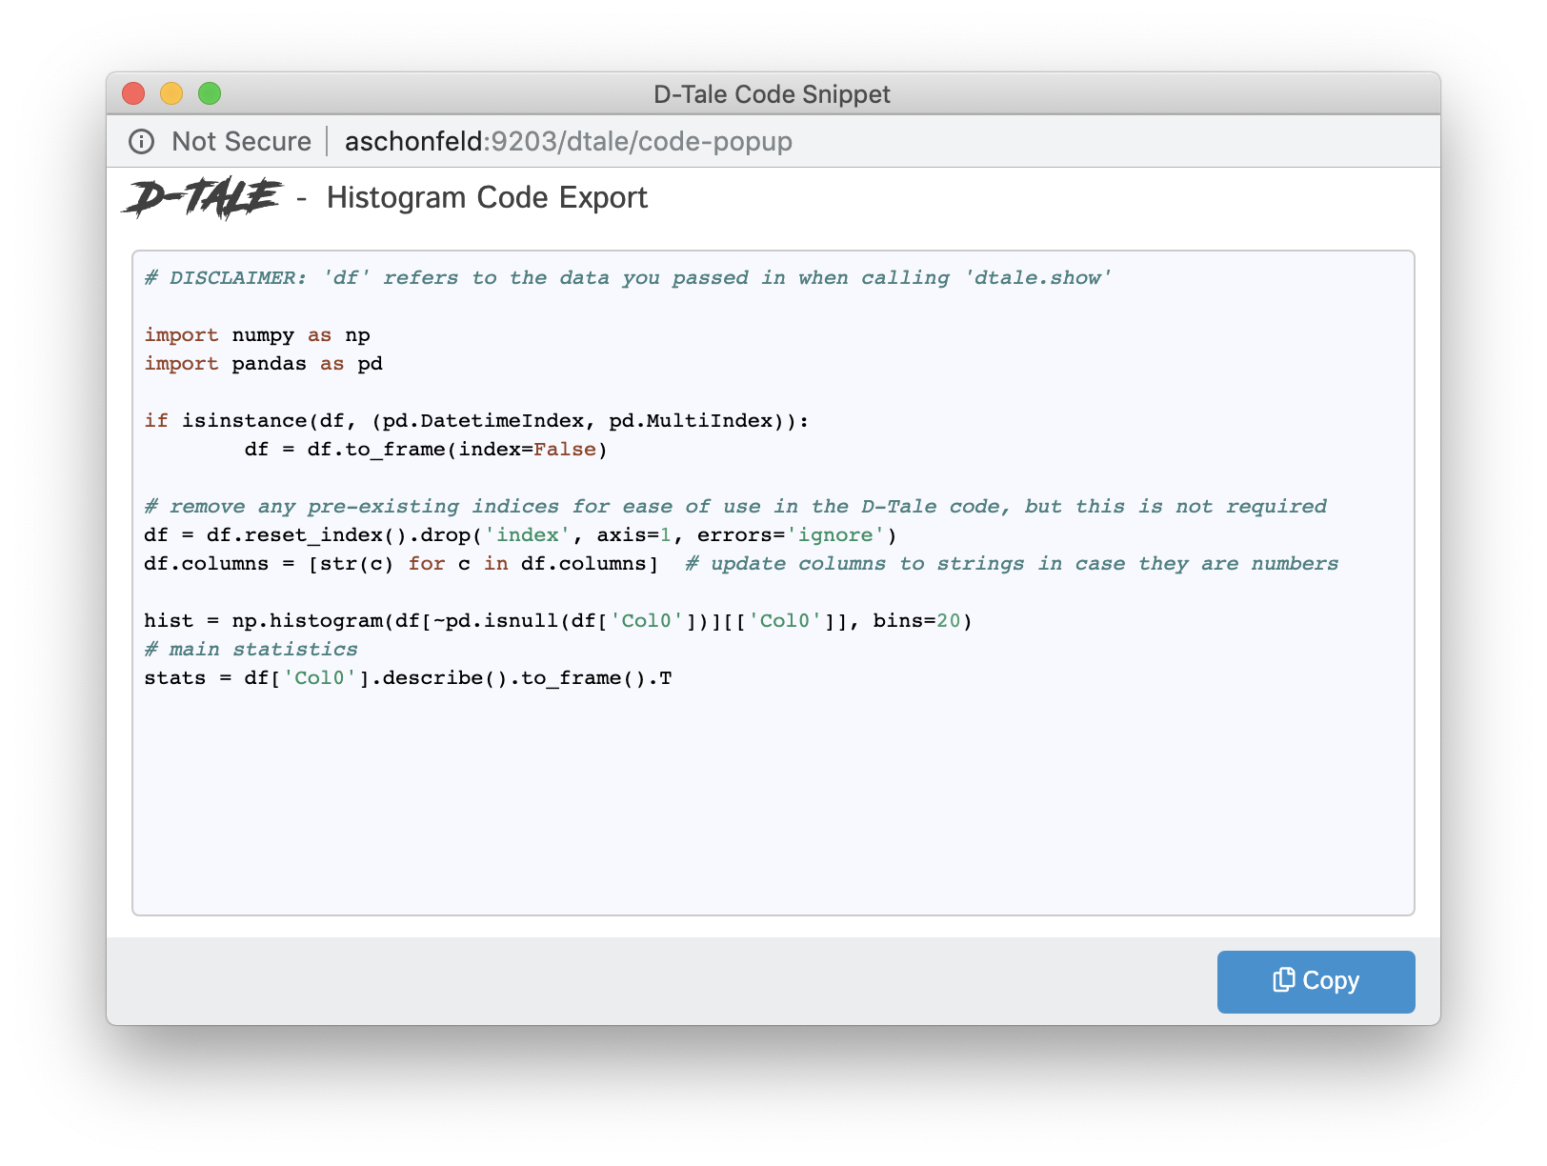
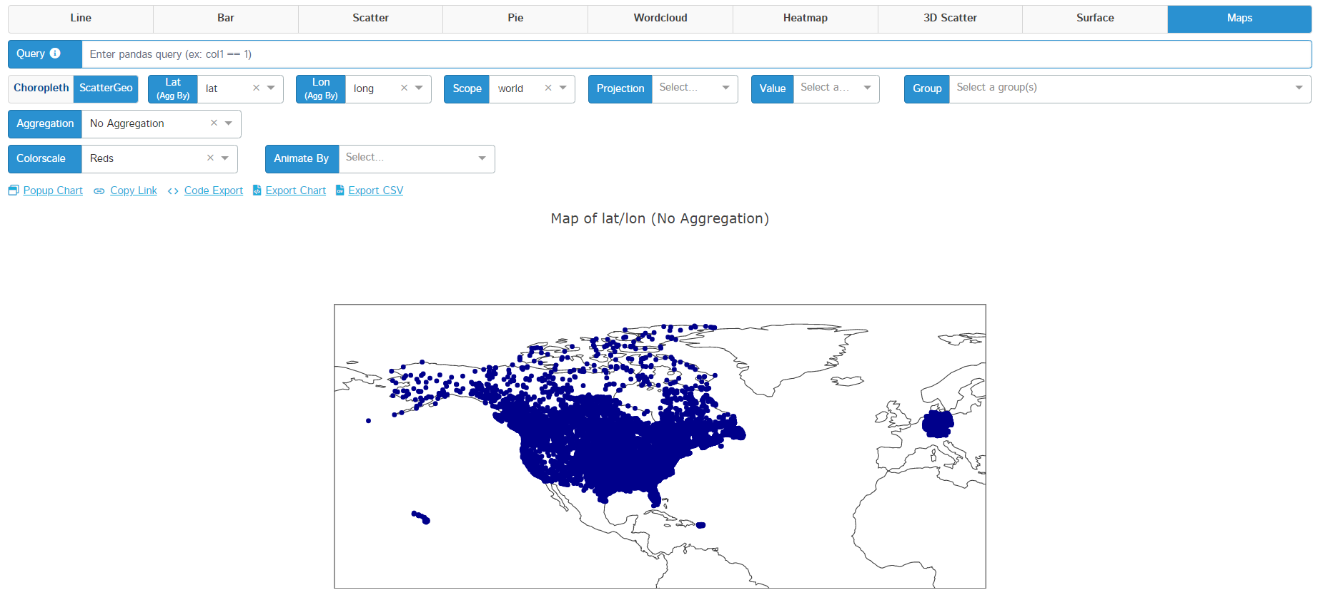
Things you can do with Dtale.
Use longitude and latitude data to plot your data points on a map.
Generate code for any operations done through the dtale UI.

Slide 16
Demo

Slide 17

Creating Web Apps with Streamlit

Slide 18
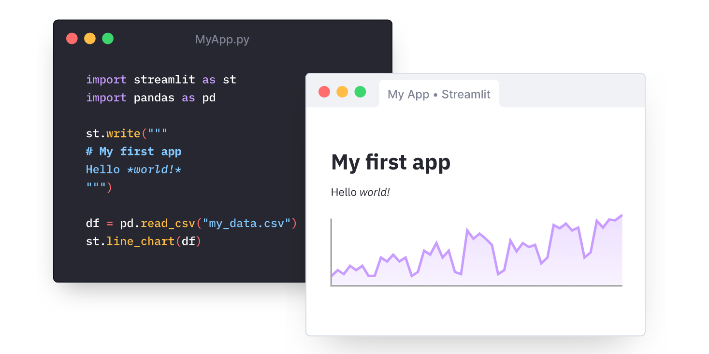
What is Streamlit?
Streamlit is an open-source python framework for building web apps for Machine Learning and Data Science. We can instantly develop web apps and deploy them easily using Streamlit. Streamlit allows you to write an app the same way you write python code.

Slide 19
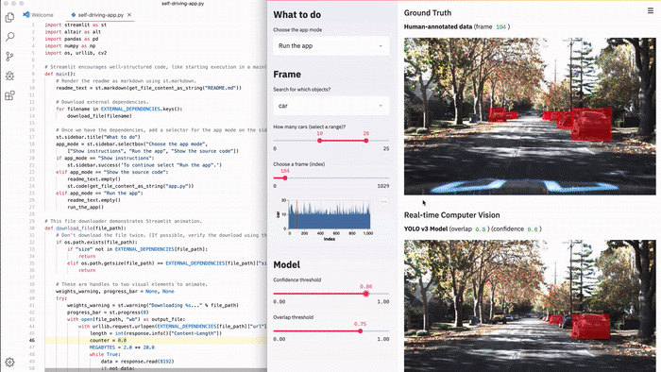
Why use Streamlit?
Simple and intuitive to use.
A flexible and quick development flow.
Allows reusability of python code.
Supports all the popular databases and APIs.
Easy to follow documentation.
A very active open-source community.

Slide 20
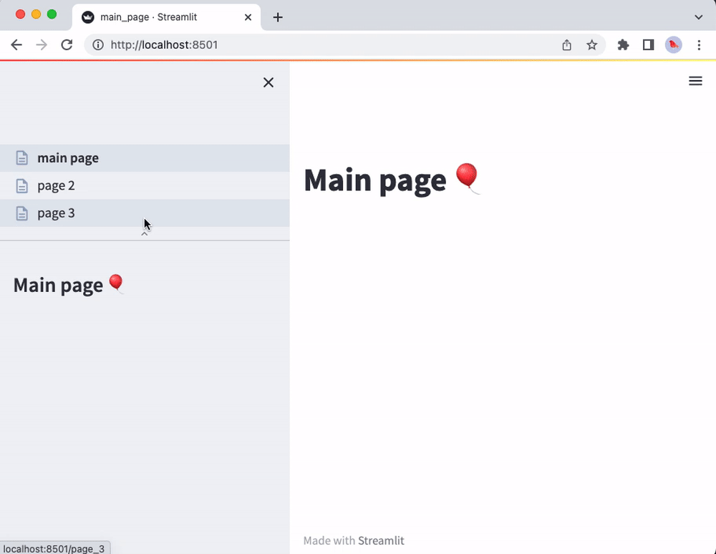
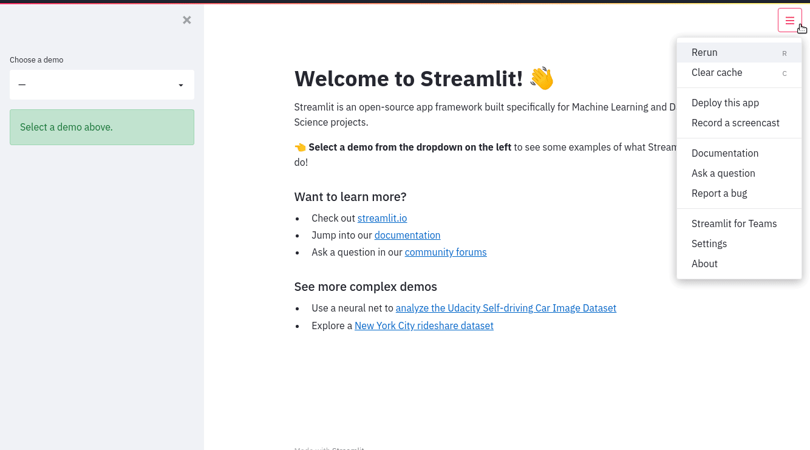
Things you can do with Streamlit
Create single and multi-page applications.

Slide 21
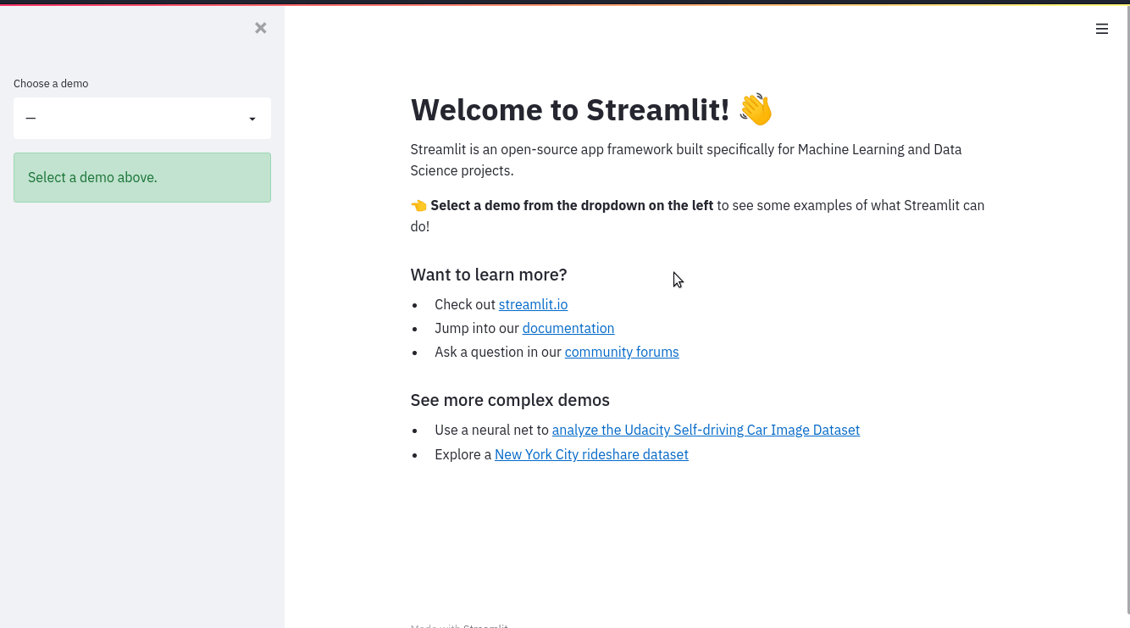
Things you can do with Streamlit
Customize the application without needing knowledge of front-end development.

Slide 22
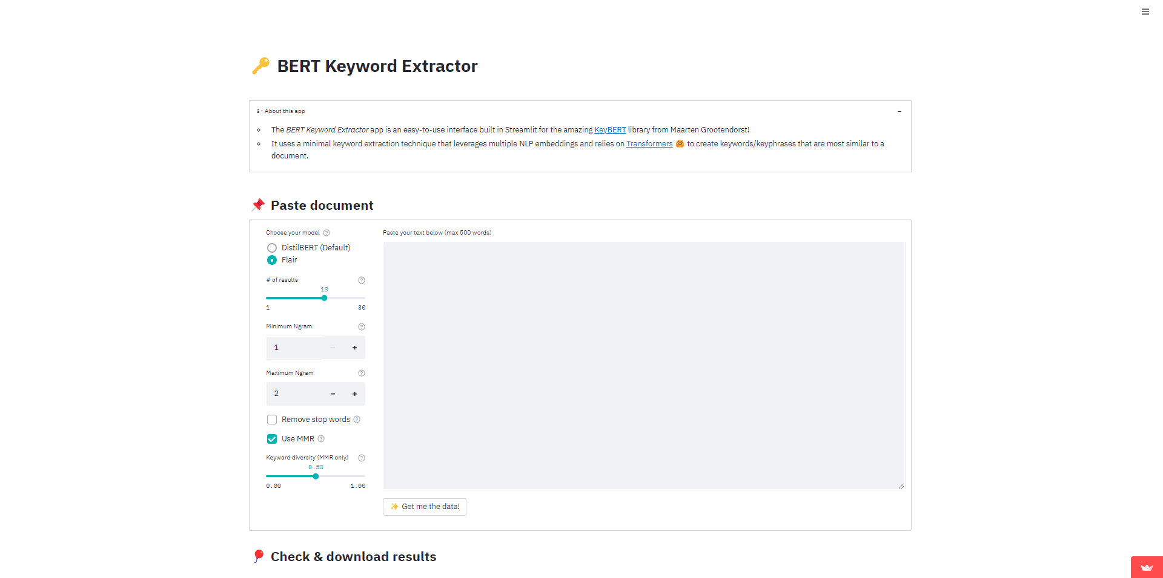
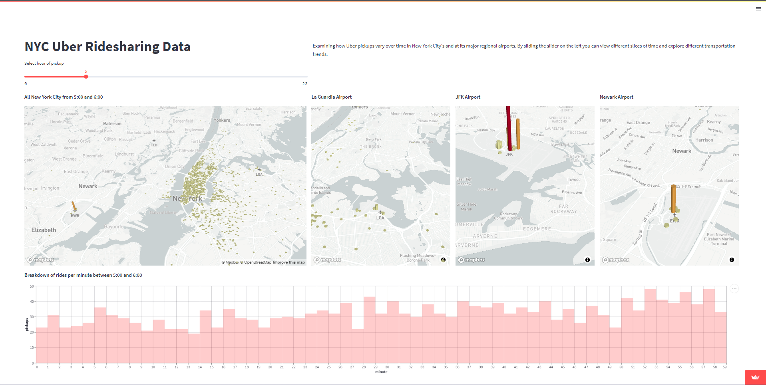
Things you can do with Streamlit
Create visually stimulating charts and graphics and deploy them in the form of a web app for your client.

Slide 23
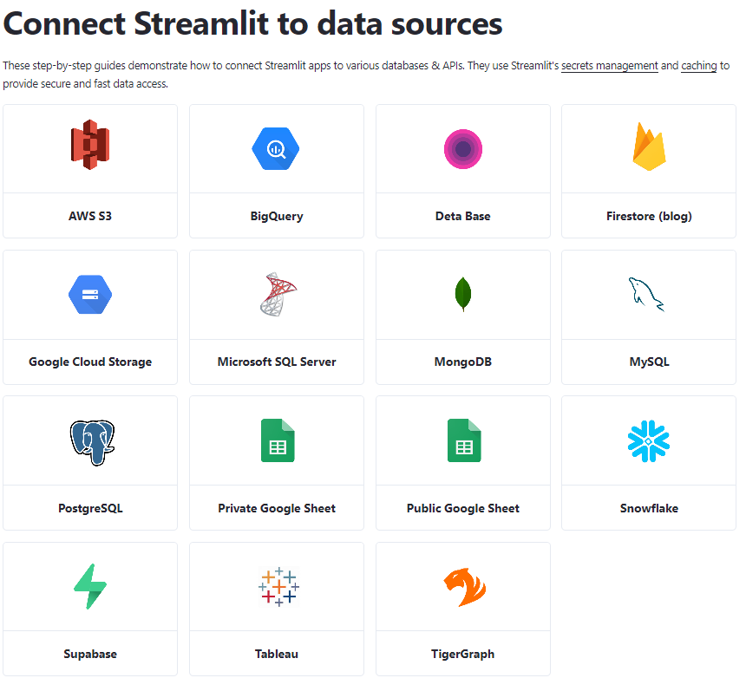
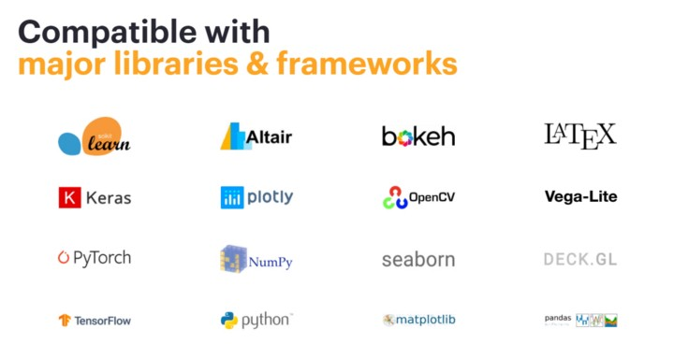
Things you can do with Streamlit
Use popular frameworks and libraries with Streamlit to create sophisticated applications.

Slide 24
Demo

Slide 25

Modeling and Experimentation with PyCaret

Slide 26
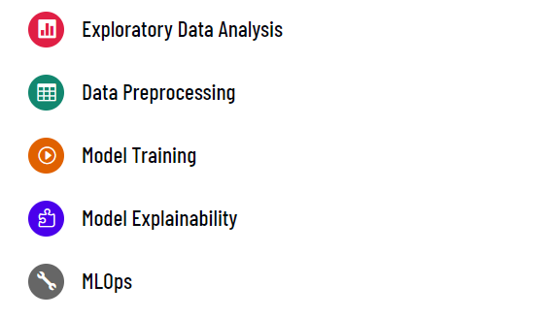
What is PyCaret?
PyCaret is an open-source, low-code machine learning library in Python that automates machine learning workflows. It is an end-to-end machine learning and model management tool that exponentially speeds up the experiment cycle and makes you more productive.

Slide 27
Why use PyCaret?
It is a low-code and fast modeling solution.
Great for running rapid experimentation and analyzing feature importance.
It is a deployment-ready library with reproducible pipeline results.

Slide 28
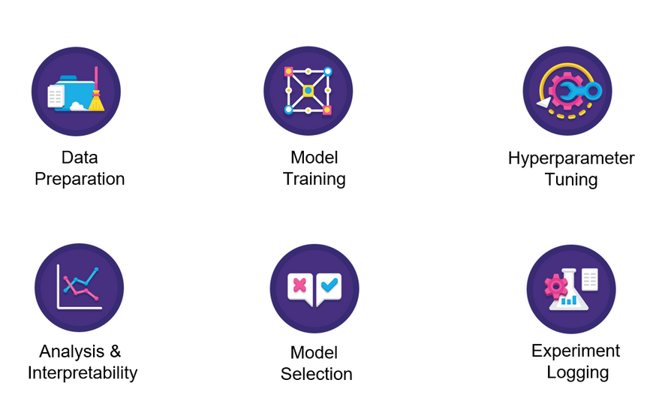
Things you can do with PyCaret
Run an end-to-end ML Pipeline for experimentations that can easily be deployed.

Slide 29
Things you can do with PyCaret
Classification
Regression
Clustering
NLP
Anomaly Detection
Time Series (Beta)
Run an end-to-end ML Pipeline for experimentations that can easily be deployed.

Slide 30
Demo

Slide 31
Questions ?

